Slide 1

Open Q & A May 19, 2017
DYNAMICS 365

Slide 2
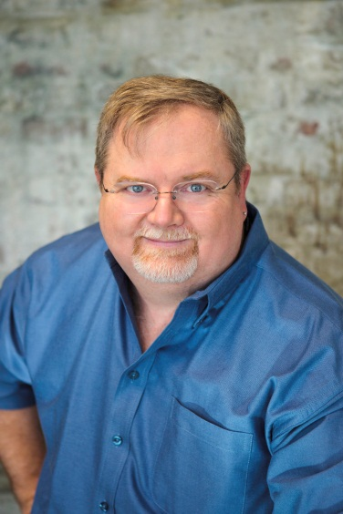
Mitch Milam
Dynamics CRM Architect
mitch@xrmcoaches.com
@mitchmilam
http://tinyurl.com/MitchMilamLinkedIn

Slide 3
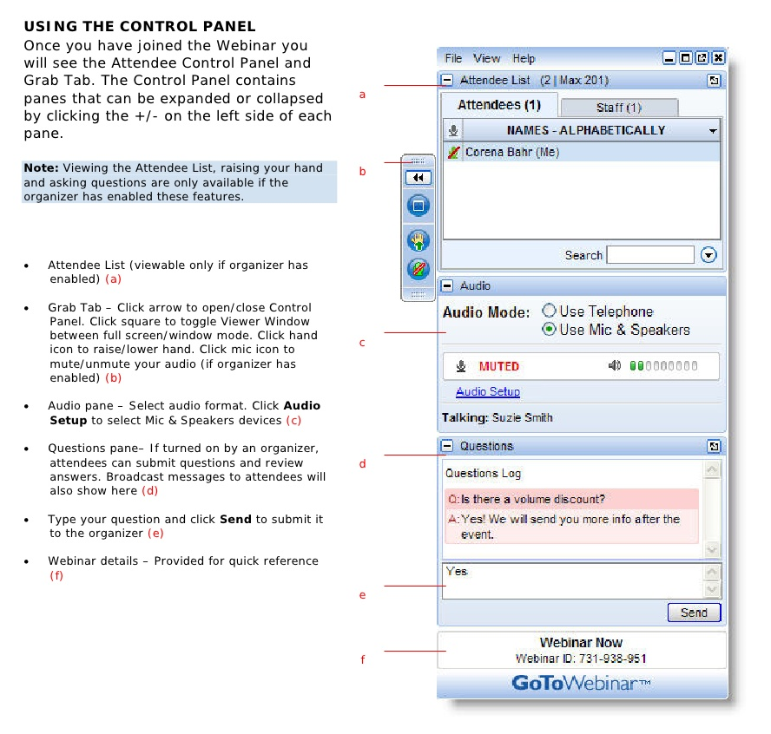
Webinar Housekeeping

Slide 4
2017 Training Resources
Webinars
http://www.xrmcoaches.com/webinars
KnowledgeBits
http://www.xrmcoaches.com/knowledgebits
Learning Plans
http://www.xrmcoaches.com/freestuff

Slide 5
And Introducing…
Ask Mitch

Slide 6
Questions?

Slide 7
Thank You

